Slide 1
Hypertextual Prototype
Welcome view
Userlogindone view
Group view
Userprofile view
Addpublication view
Settingaccount view
Signup view

Slide 2
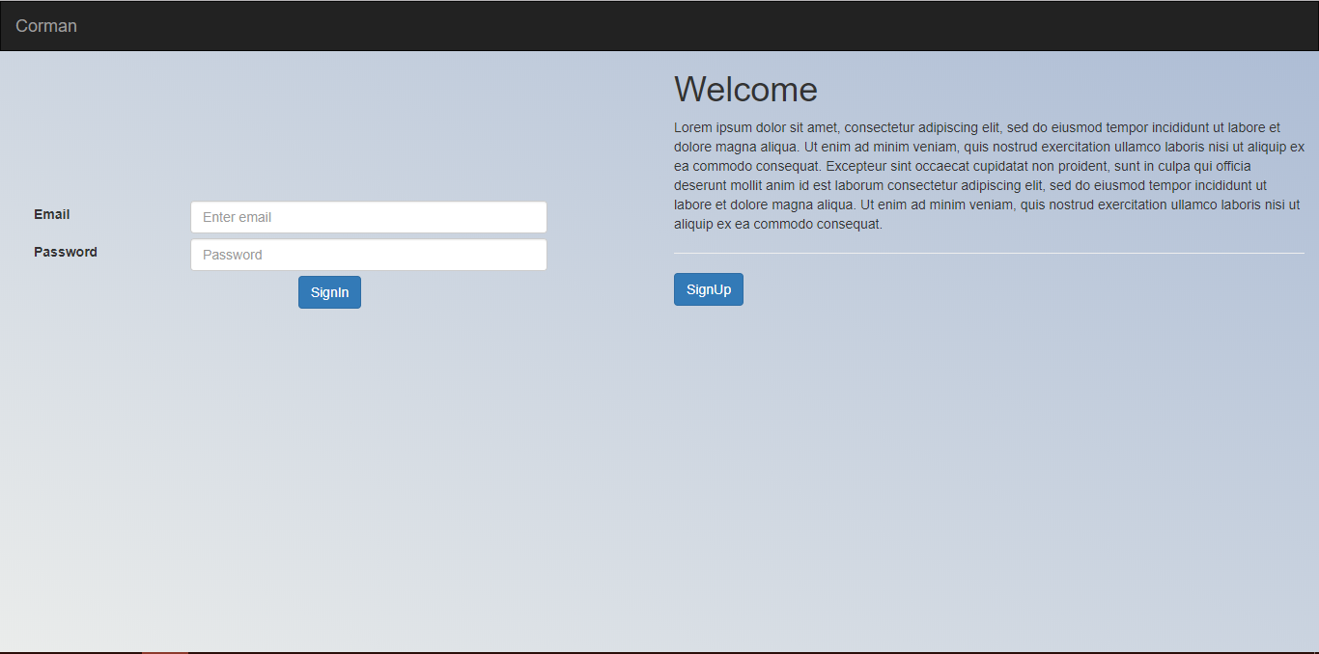



WELCOME

Slide 3
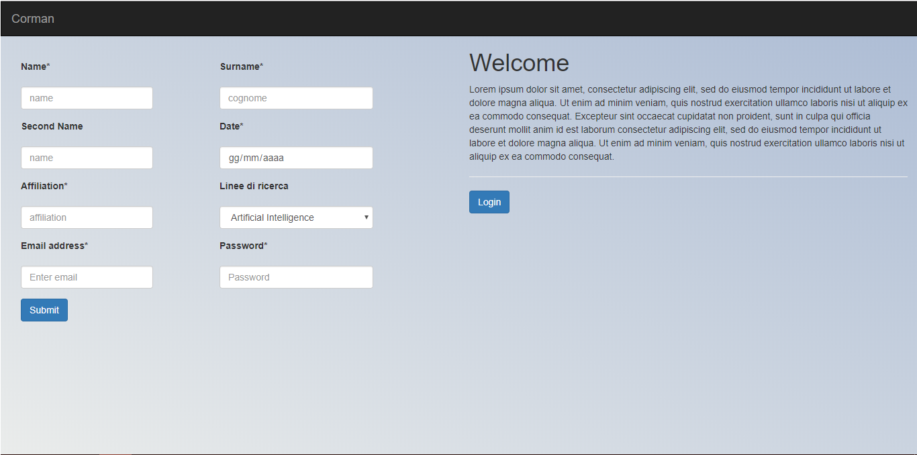



SIGNUP

Slide 4
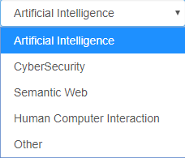
SIGNUP

Slide 5

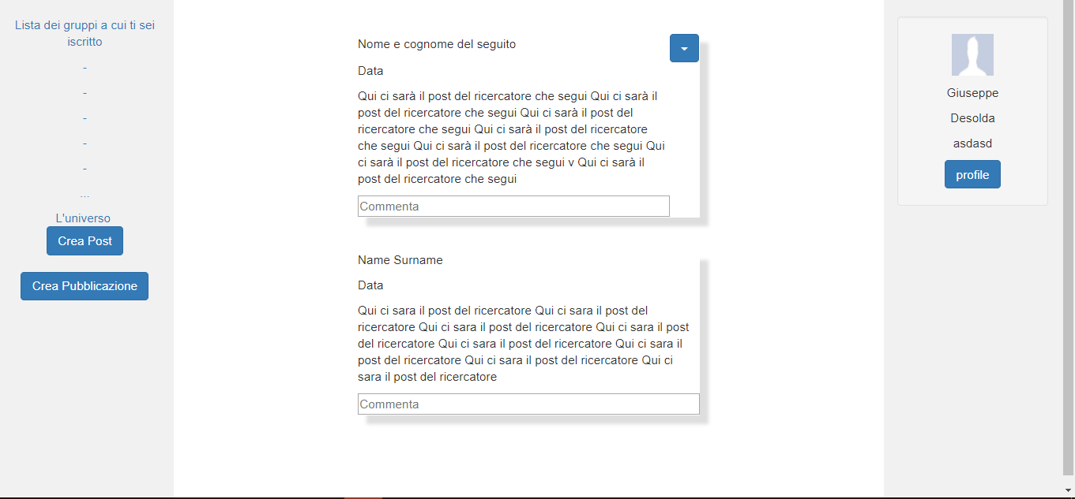





USERLOGINDONE

Slide 6
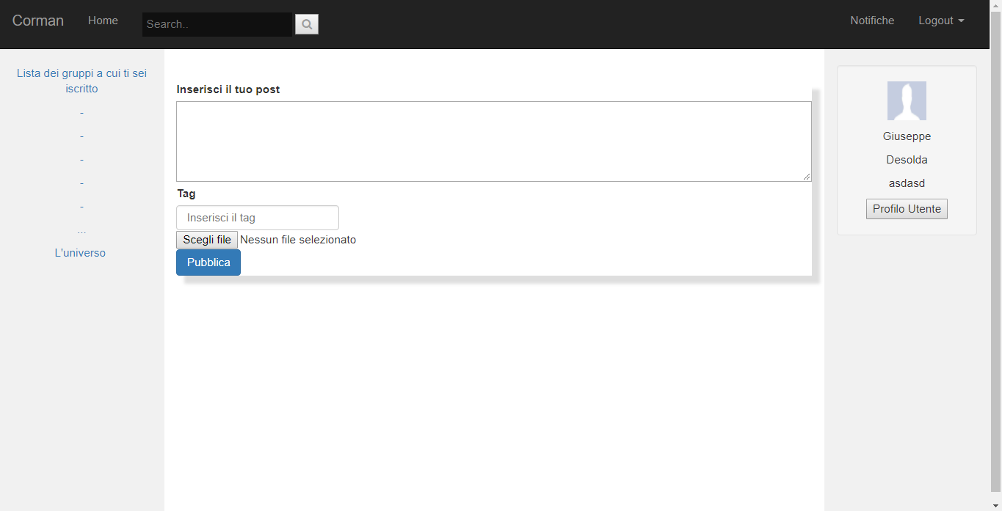
ADDPOST
USERLOGINDONE

Slide 7
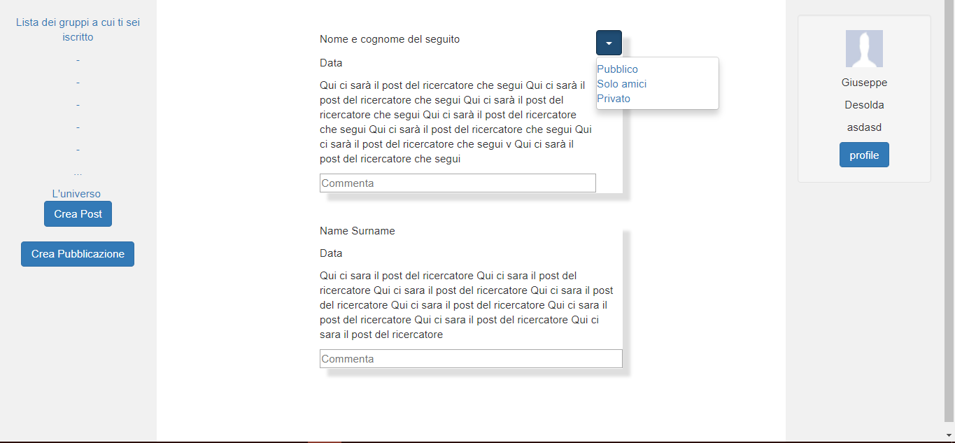
POST
USERLOGINDONE

Slide 8
PUBBLICAZIONI
ADDPOST
USERLOGINDONE

Slide 9
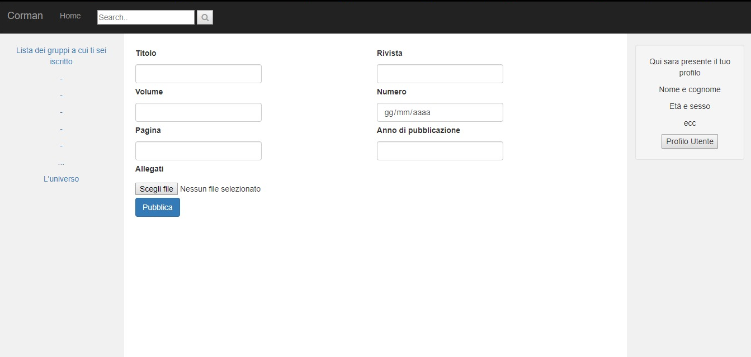

ADDPUBLICATION

Slide 10
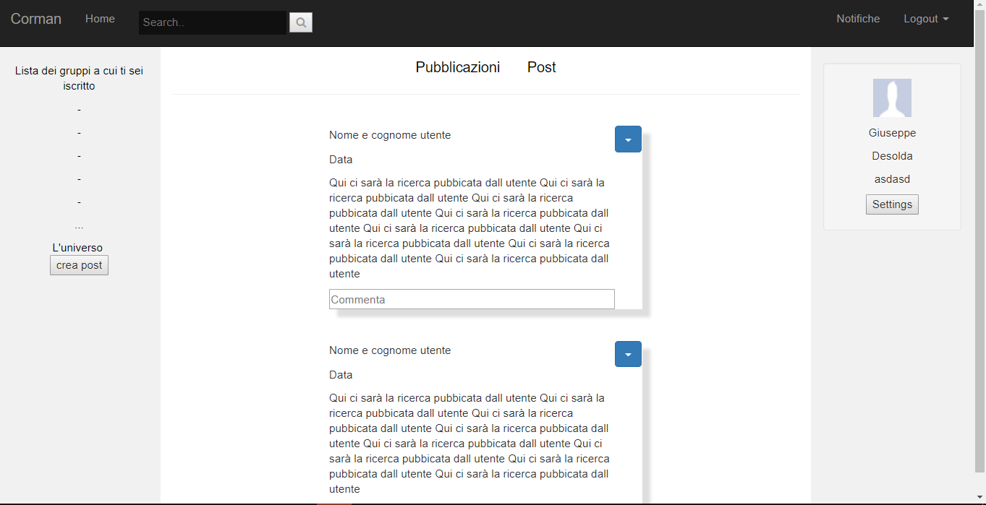

USERPROFILE

Slide 11
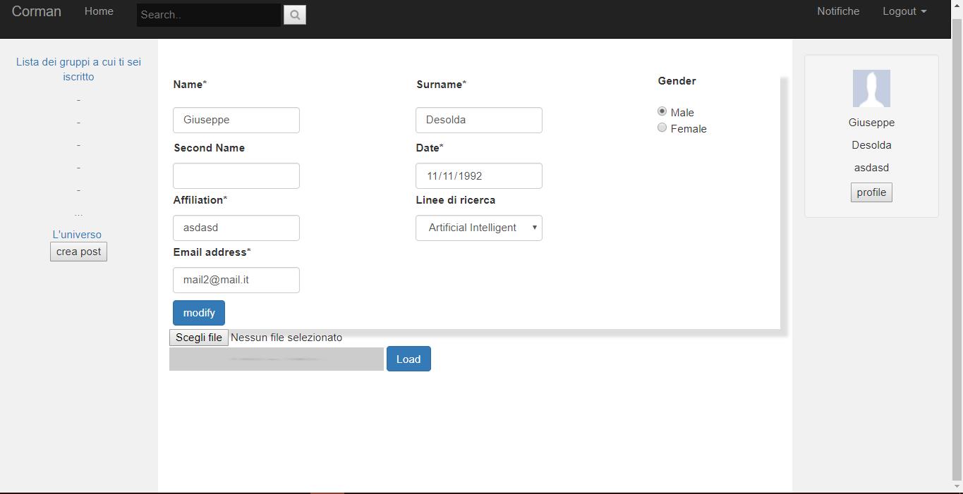

SETTINGACCOUNT

Slide 12
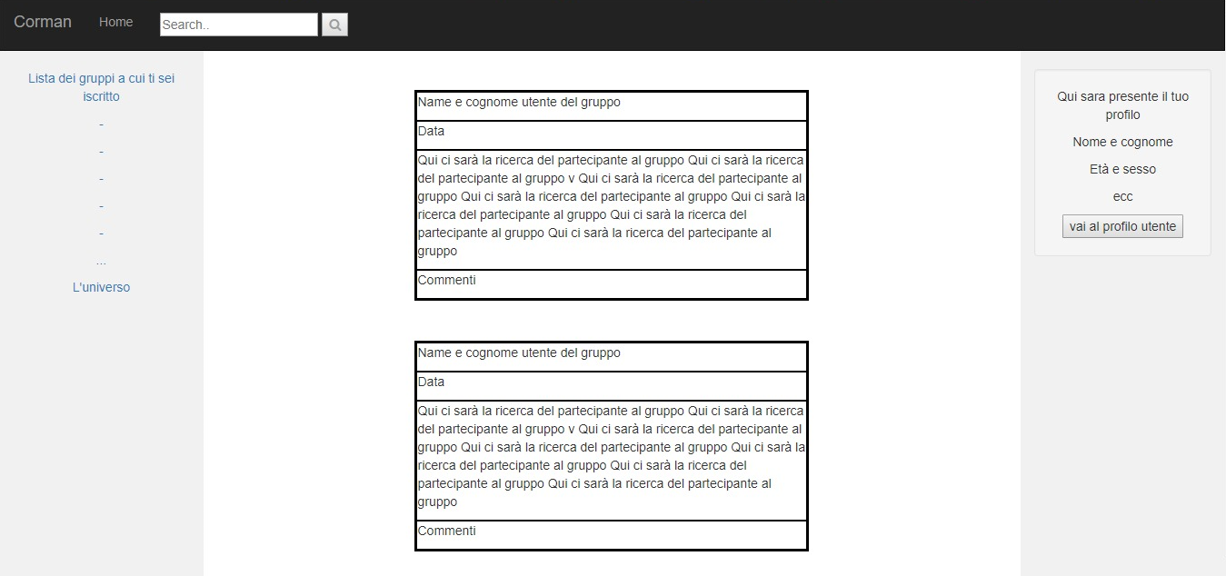
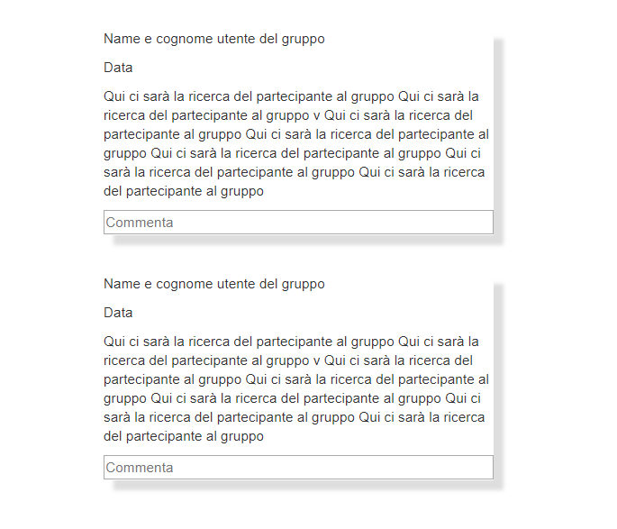
GROUP

Slide 13


WORK IN PROGRESS

